Slide 1
Data Structures
Lecture 7
Minutes Before Mid
Prantik Paul [PNP]
Lecturer
Department of Computer Science and Engineering
BRAC University

Slide 2
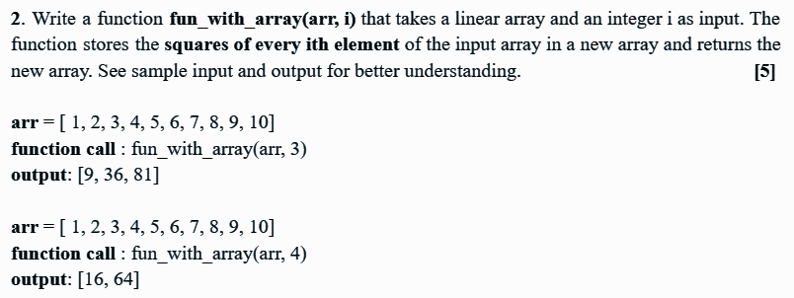
Quiz problems review

Slide 3
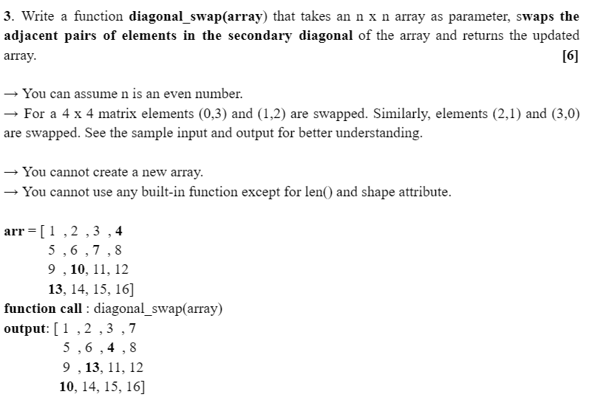
Quiz problems review

Slide 4
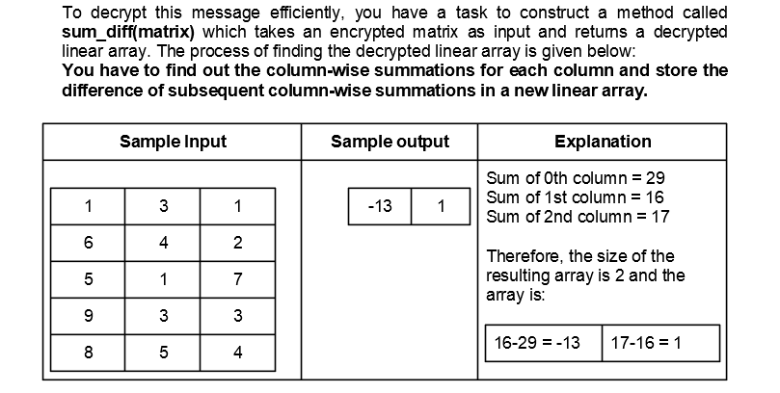
Mid problems review

Slide 5
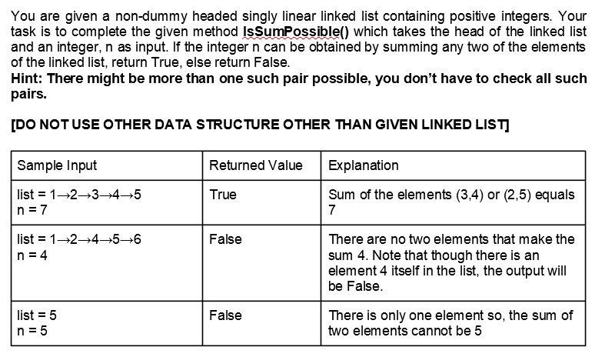
Mid problems review

Slide 6
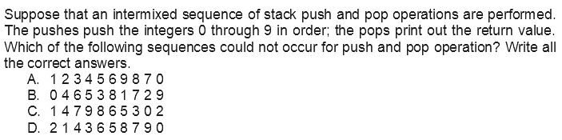
Mid problems review

Slide 7
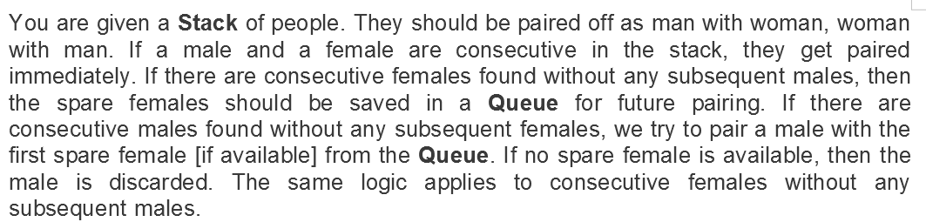
Mid problems review

Slide 8
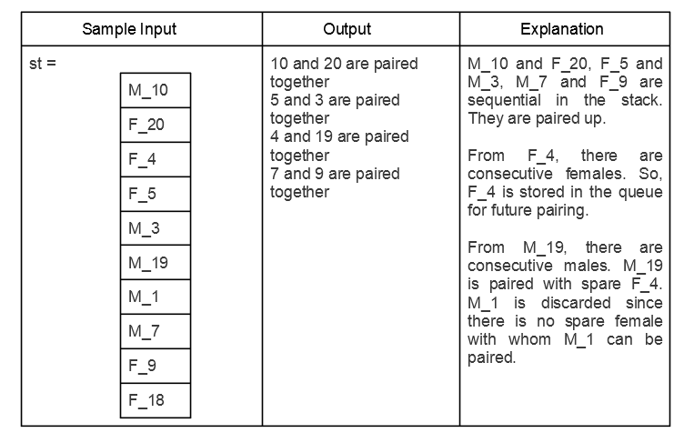
Mid problems review

Slide 9
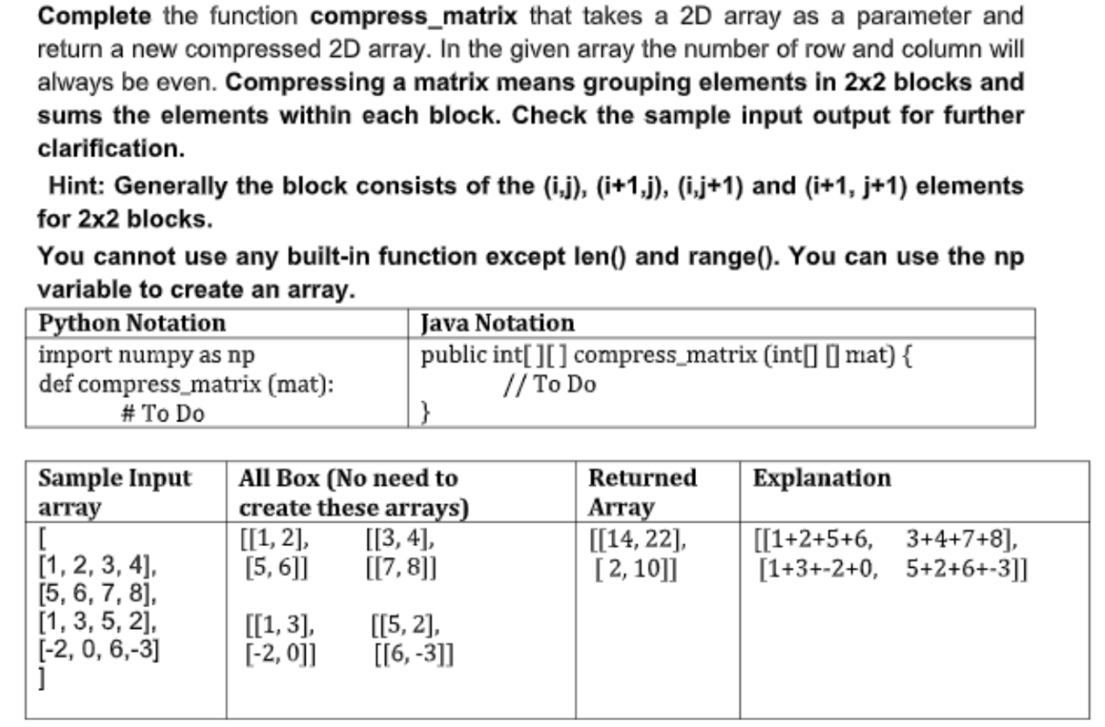
Mid problems review

Slide 10
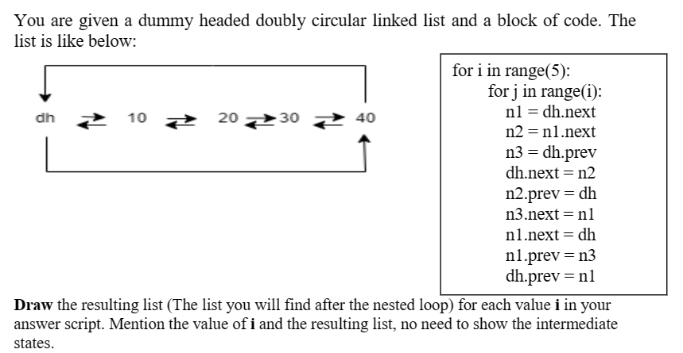
Mid problems review

Slide 11
Linked List (Problems)
Deleting all Occurance of a particular element

